Slide 1
Crime in the US vs. School Investment
A Data Analysis project by Scott McLaughlin

Slide 2
Hypothesis
Crime will be measurably lower in states that spend more on education
Multiple years will be analyzed
Investment compared with crime four years later to show possible causality
Investment compared with crime in same year to show trend
Strength of correlation will vary by year and by type of crime
Not intended to show causation conclusively
School spending is suggestive of social policy for each state
Work will be don using both R Studio and Python

Slide 3
Values
School spending
Dollars per student per school day
Consists of instruction + administrative + misc. costs
Excludes capitol spending
Crime shown as instance per 100k of population

Slide 4
Crime vs school spending - R language
The following slides show how violent and property crime relate to school spending four years earlier. Where there are trends, a possible causation is indicated. There are many factors not taken into account, however. Trends therefore support causation, but do not prove it.
State names are omitted for chart readability. Multiple years are included, click on chart and press arrows to navigate.
Multiple years are plotted on each page. Click image and hit left or right arrows to view

Slide 5
Violent Crime

Slide 6
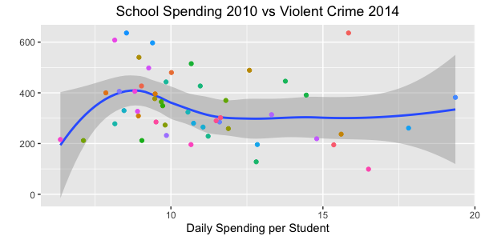

Slide 7
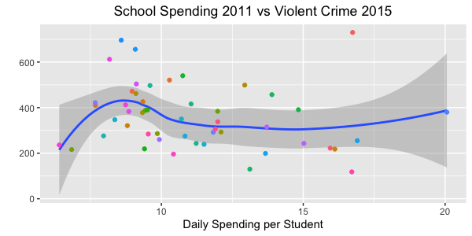

Slide 8
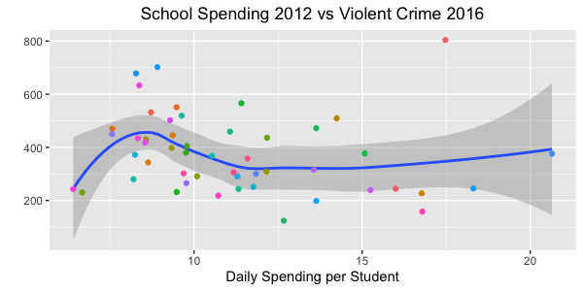

Slide 9
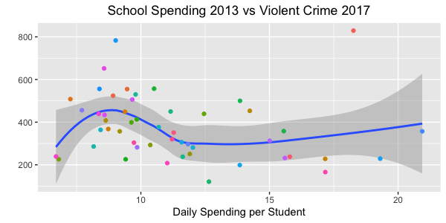

Slide 10
Property Crime

Slide 11
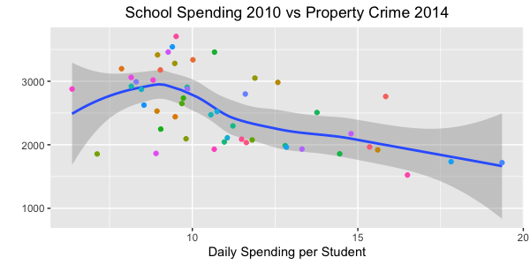

Slide 12
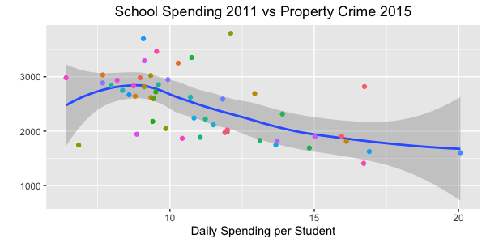

Slide 13
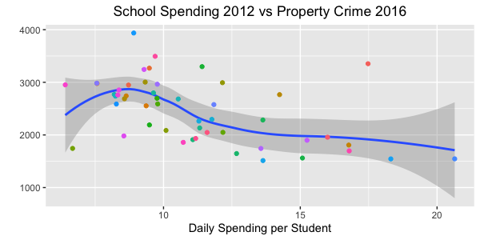

Slide 14
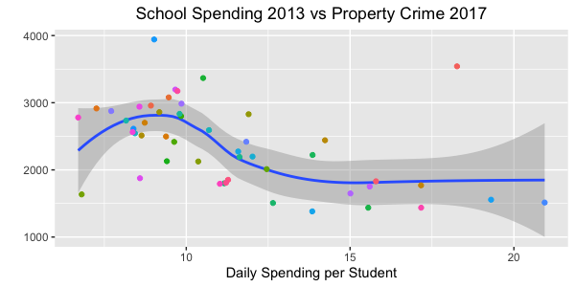

Slide 15
The following slides relate school spending to same year violent and property crime. The correlations here are likely based on prior year school spending. There is, however, an interesting indication that policy changes can have more immediate effects. More research would be required to support this idea.

Slide 16
Violent Crime

Slide 17
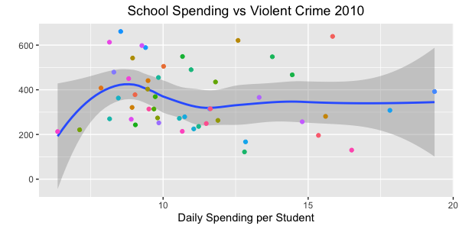

Slide 18
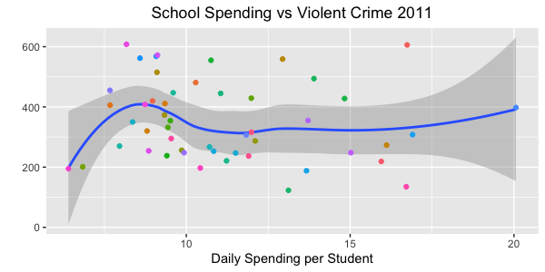

Slide 19
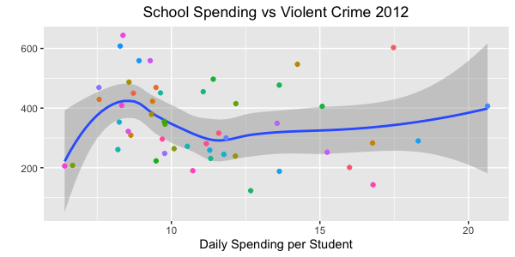

Slide 20
Property Crime

Slide 21
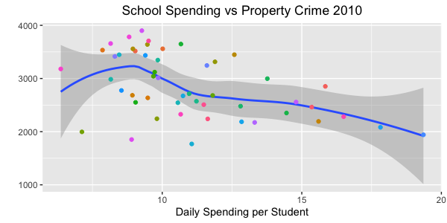
Caption

Slide 22
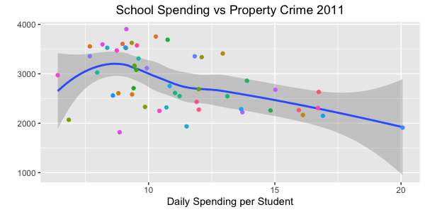
Caption

Slide 23
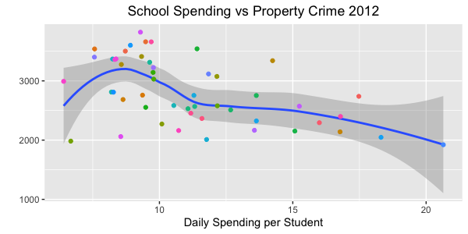
Caption

Slide 24
Conclusions after work from R
Both property crime and violent crime are directly correlated to school spending.
Correlation holds true for spending four years earlier and for spending in current year.
Correlation within current year likely tied to prior year spending
Greatest change occurs between ~$9 and ~$12 per student day
Trend continues with higher spending, but has more variation in data

Slide 25
Crime vs school spending - Python
The following slides plot crime vs. school spending, as in slides above. The legend identifies some of the states, but not all to preserve legibility. Here a trend-line is not included, but the general tendencies for violent and property crime as seen previously can still be identified visually.
Crimes are instances per 100k of population.
School spending is in daily instructional spending per student. Includes direct instruction, administrators, and misc. spending. Excludes capital costs.
Multiple years are plotted on each page. Click image and hit left or right arrows to view
Interactive HTML files can be found in the “html_images” folder that accompanies this presentation.

Slide 26
Violent Crime

Slide 27
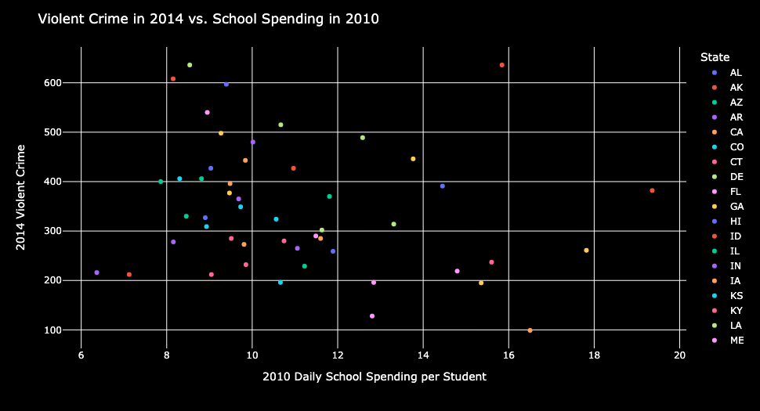
Violent Crime vs. School Spending 4 years earlier

Slide 28
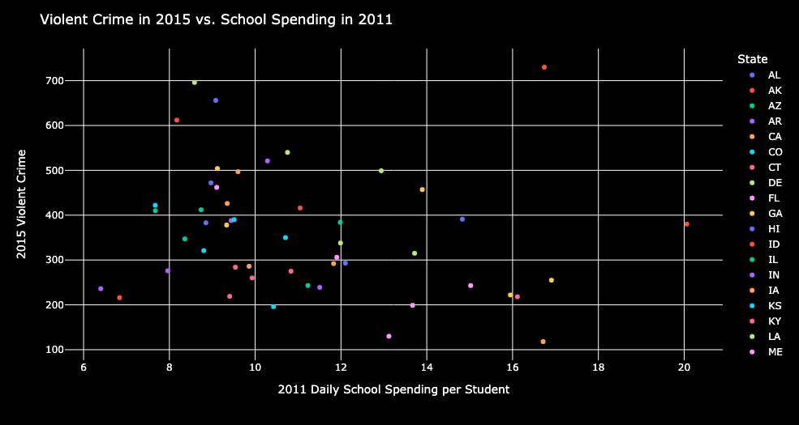
Violent Crime vs. School Spending 4 years earlier

Slide 29
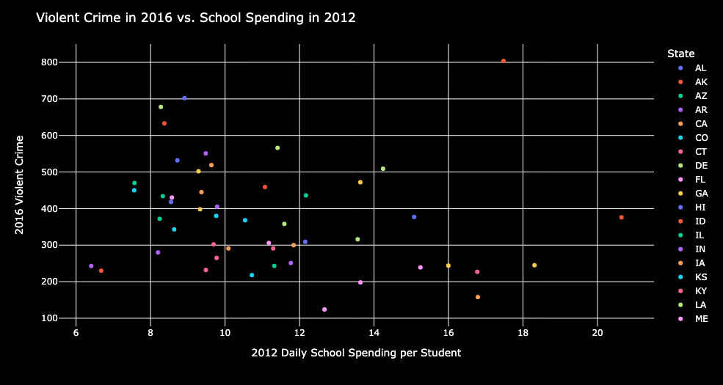
Violent Crime vs. School Spending 4 years earlier

Slide 30
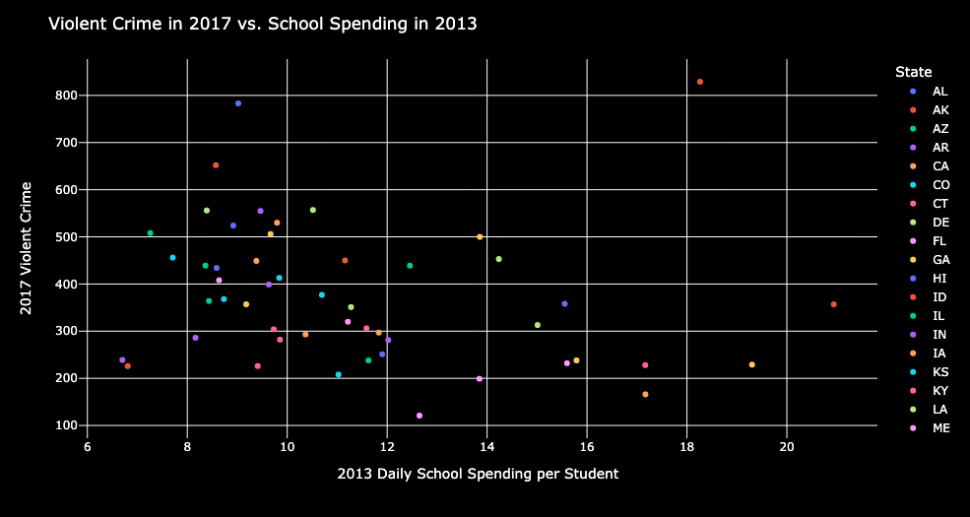
Violent Crime vs. School Spending 4 years earlier

Slide 31
Property Crime

Slide 32
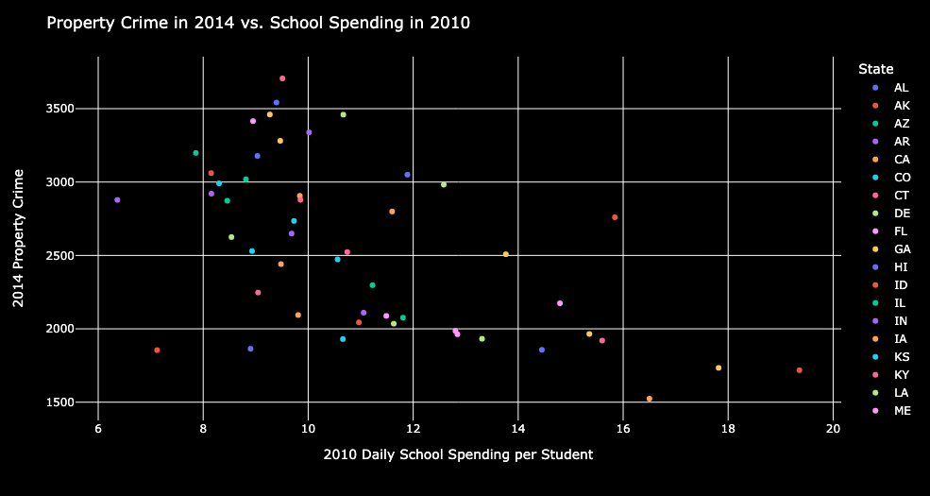
Property Crime vs. School Spending 4 years Earlier

Slide 33
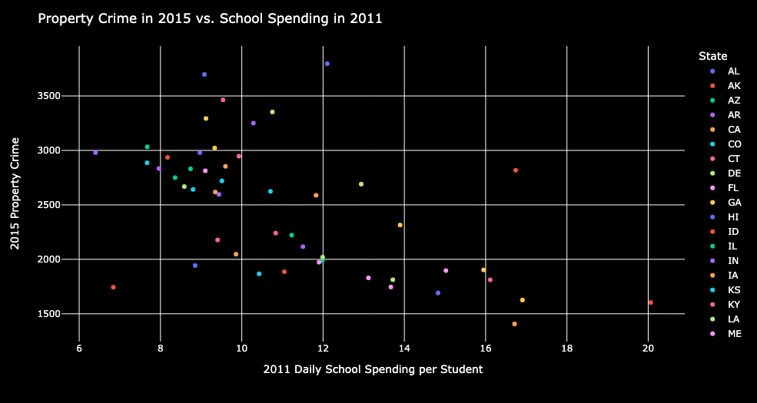
Property Crime vs. School Spending 4 years Earlier

Slide 34
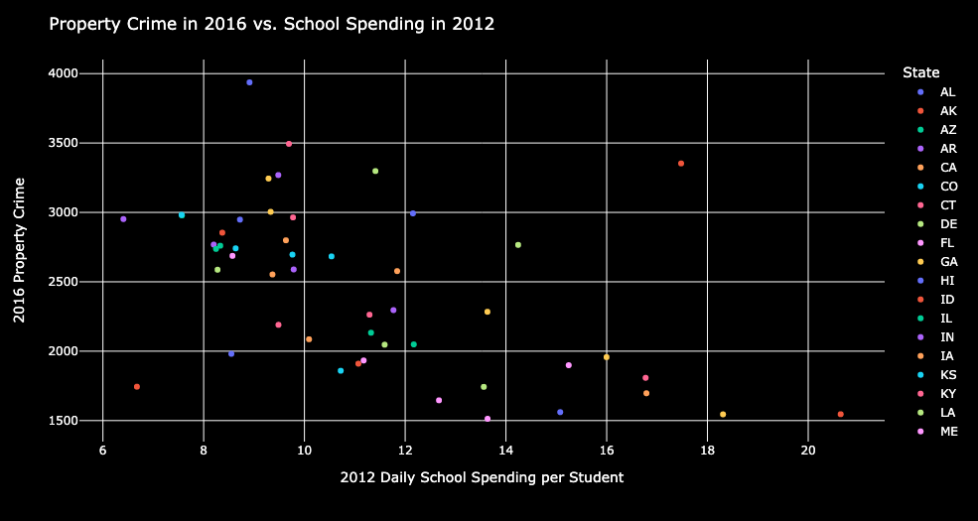
Property Crime vs. School Spending 4 years Earlier

Slide 35
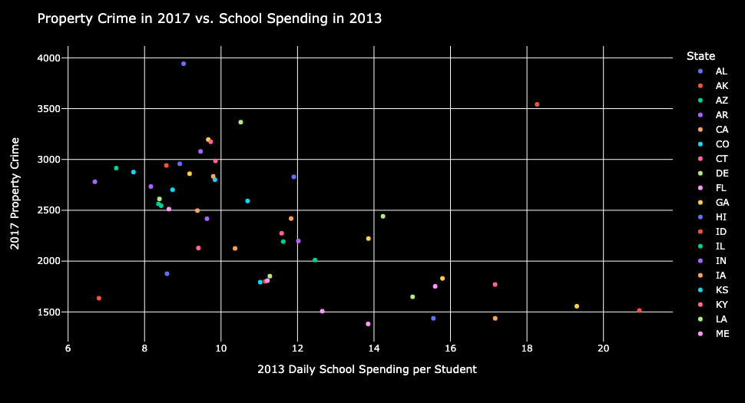
Property Crime vs. School Spending 4 years Earlier

Slide 36
Violent Crime

Slide 37
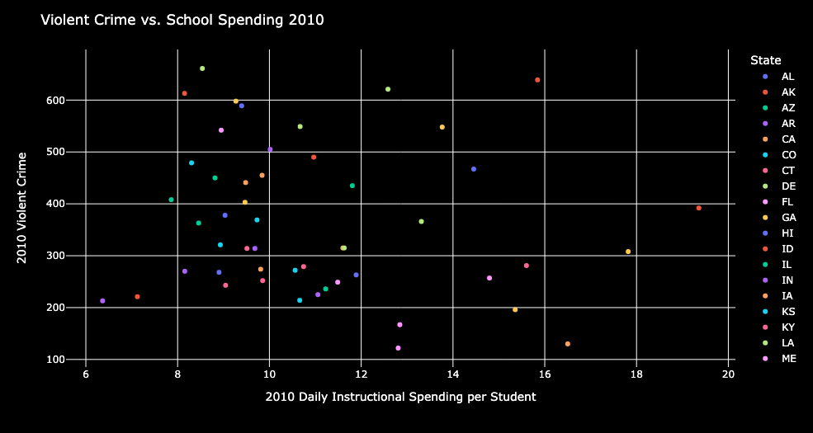
Violent Crime vs. School Spending in Same Year

Slide 38
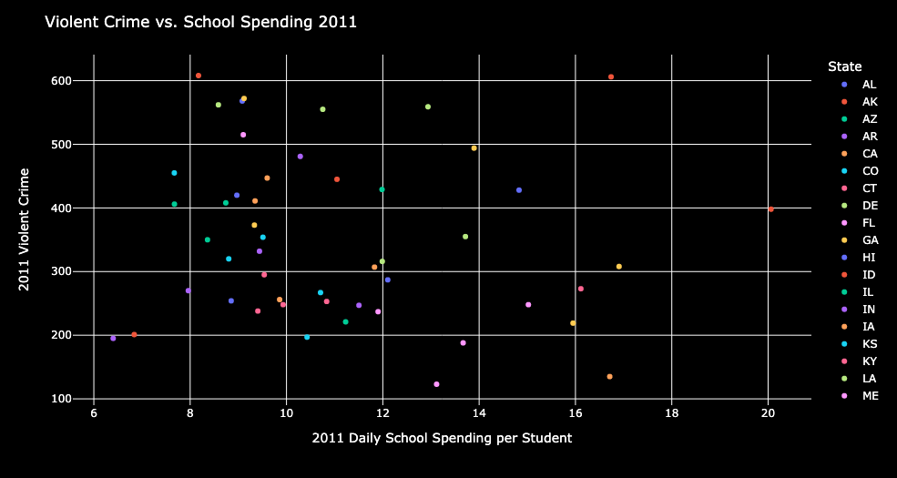
Violent Crime vs. School Spending in Same Year

Slide 39
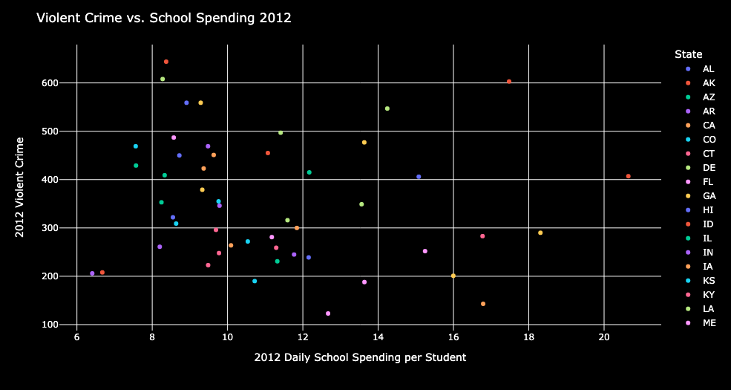
Violent Crime vs. School Spending in Same Year

Slide 40
Property Crime

Slide 41
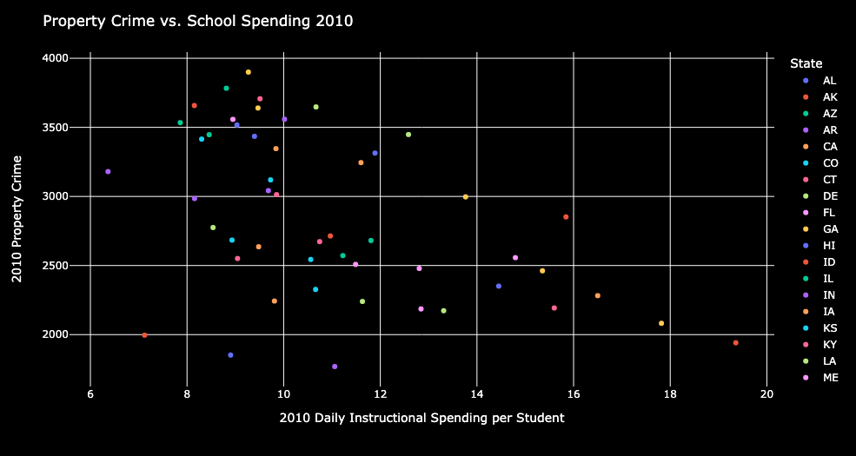
Property Crime vs. School Spending in Same Year

Slide 42
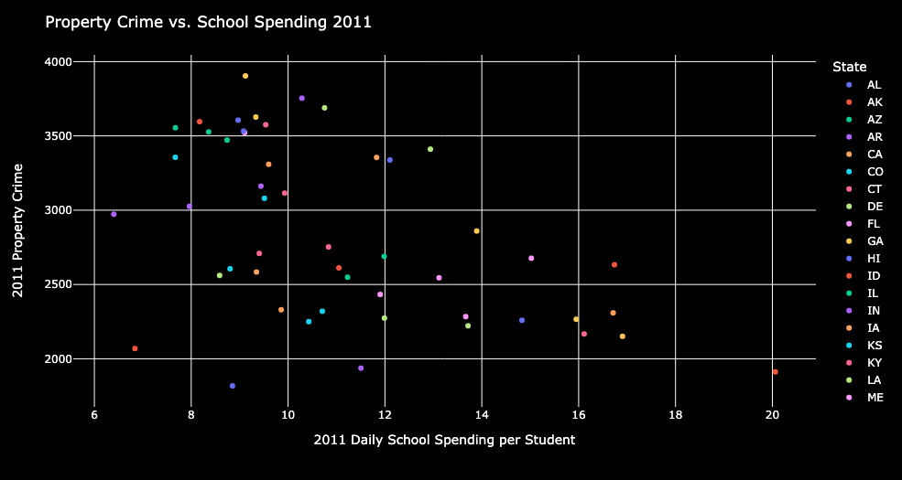
Property Crime vs. School Spending in Same Year

Slide 43
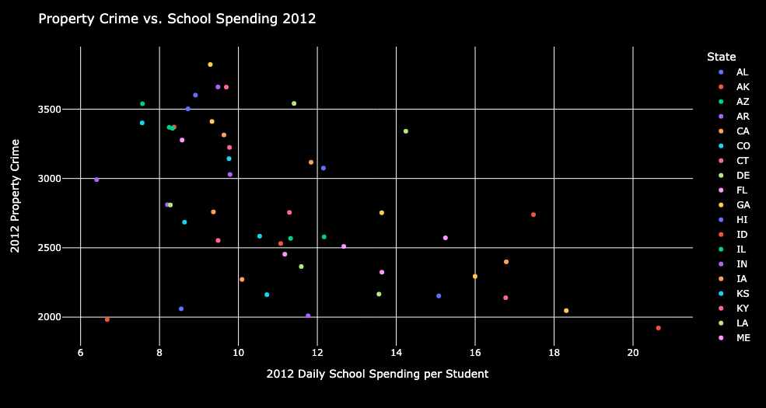
Property Crime vs. School Spending in Same Year

Slide 44
Final Conclusions
There is a strong correlation between spending more on student instruction and reducing both violent crime and property crime. This is seen whether looking with a four year lag from spending to crime, or even same year spending to crime.
While the same year correlation is likely due to spending in prior years, it has implications for more immediate return on investment for policy changes.

Slide 45
Sources
Thompson, Melissa. Gender, Mental Illness, and Crime in the United States, 2004 [Computer file]. ICPSR27521-v1. Ann Arbor, MI: Inter-university Consortium for Political and Social Research [distributor], 2011. doi:10.3886/ICPSR27521
https://catalog.data.gov/dataset/gender-mental-illness-and-crime-in-the-united-states-2004-42fde
FBI Crime/Law Enforcement Stats (Uniform Crime Reporting Program)
https://ucr.fbi.gov/crime-in-the-u.s

